Slide 1
FEMALE GENITAL MUTILATION
KIMATHI KELVIN M.
C025-01-1221/2019.
Issue on the African Society

Slide 2
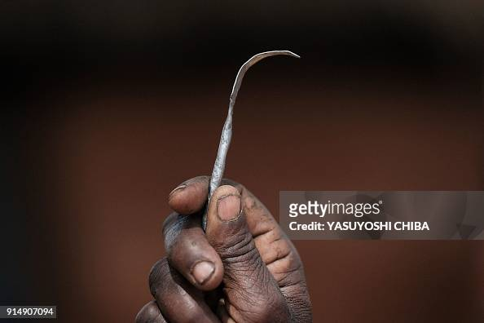
The Enduring Shadow: Female Genital Mutilation, Its Devastating Effects, and the Road to Eradication

Slide 3
Lets Join Hands to Fight the Scorge
Female Genital Mutilation (FGM), also known as Female Genital Cutting (FGC), is a deeply entrenched practice with devastating consequences. Defined by the World Health Organization (WHO) as any procedure involving partial or total removal of the external female genitalia, or other injury to the genital organs for non-medical reasons, FGM is a violation of human rights and a global public health concern. This essay delves into the history and justifications for FGM, explores the profound physical and psychological effects it has on women and girls, and examines ongoing efforts to eradicate this harmful practice.

Slide 4
The origins of FGM remain shrouded in mystery, with evidence suggesting its practice across continents for millennia. Theories posit links to cultural beliefs about purity, femininity, and societal control over female sexuality. Proponents often cite reasons like:
1.)Cultural Tradition:FGM can be seen as a rite of passage, marking a girl's transition to womanhood and ensuring her eligibility for marriage.
2.)Social Pressures: Community pressure and fear of social exclusion can drive families to continue the practice despite potential health risks.
3.)Religious Misinterpretations: Though no major religion endorses FGM, misinterpretations of religious texts are sometimes used to justify it.
4.)Economic Benefits: In some cases, FGM is mistakenly believed to increase a girl's marriageability and dowry.

Slide 5
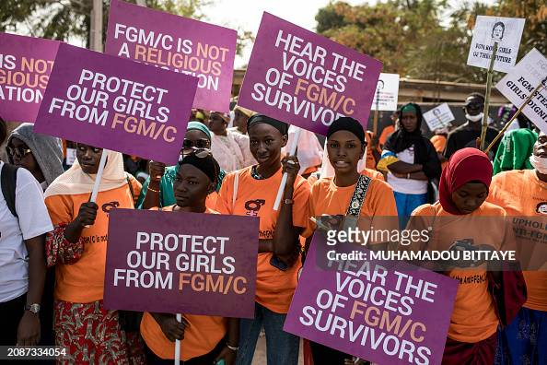
LETS JOIN HANDS TO END THE SCORGE

Slide 6
LETS JOIN HANDS TO END THE SCORGE
The international community has made significant strides in combating FGM. Public awareness campaigns have increased and many countries have enacted laws against the practice. However, challenges remain:

Slide 7
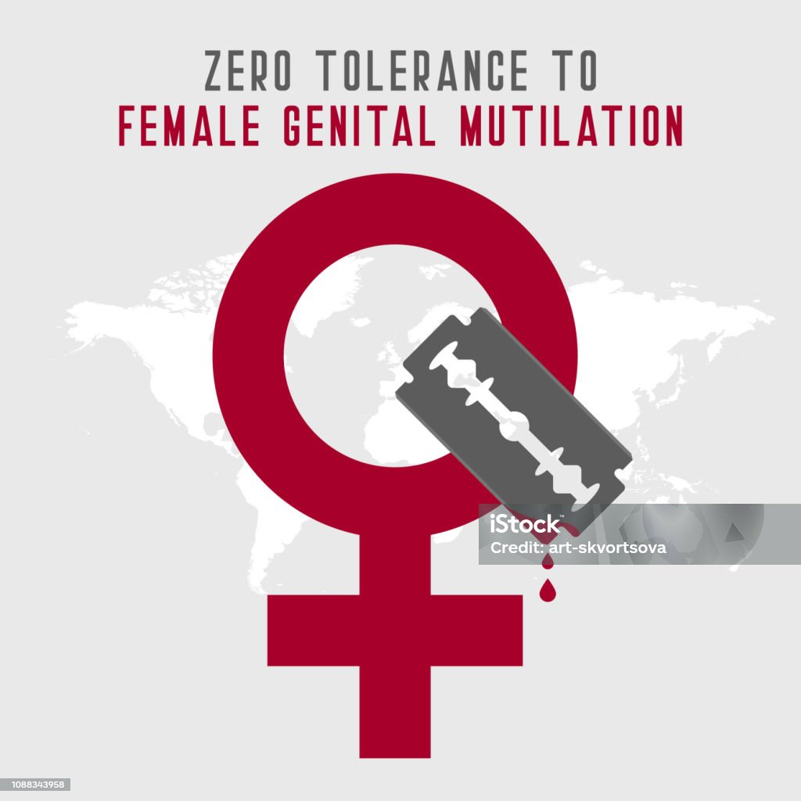
LETS JOIN HANDS TO END THE SCORGE

Slide 8

LETS JOIN HANDS TO END THE SCORGE

